Slide 1

Presentation on
FlickPick – Your Smart Movie Companion
A PERSONALIZED MOVIE RECOMMENDATION SYSTEM
BY
VAISHNAVI PANDEY 2214670010047
PRIYANKA PATEL 2214670010041
Institute of Engineering and Technology
Deen Dayal Upadhaya Gorakhpur University
Under Guidance Of
Mr. Suryabhan sir
Mrs. Shivangi Srivastav

Slide 2
TABLE OF CONTENTS
Introduction
System Architecture
System Workflow
Recommendation Technique (Content Based)
Recommendation Technique (Collaborative)
Hybrid Approach Implementation
Flask Integration
Frontend
Deployment
Project Demo
Challenges
Future Enhancements
Conclusion
References

Slide 3
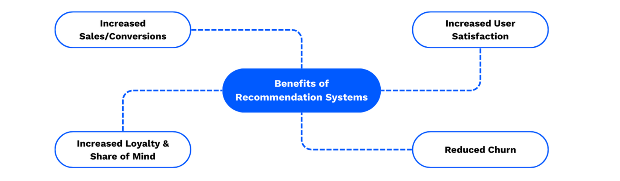
Introduction
The FlickPick movie recommendation system is designed to deliver personalized movie suggestions by combining content-based filtering and collaborative filtering techniques.It uses the Singular Value Decomposition (SVD) (Koren et al., 2009) [1], (Burke, 2002) [3] algorithm for collaborative filtering and cosine similarity for content-based filtering.The hybrid model enhances accuracy and personalization.The project is deployed using Flask on the backend and hosted via Render, with the frontend styled using React and Tailwind CSS and deployed on Netlify.

Slide 4
System Architecture
Frontend:
Developed using React.js and Tailwind CSS
Contains stylish components like animated backgrounds and hoverable movie cards
Enables user interaction and displays real-time recommendations
Backend:
Built using Flask
Hosts machine learning models for recommendation
Connects with TMDB API (TMDB API Documentation, 2024) [5]
for dynamic movie data
Preprocessing:
Processes movie metadata and ratings
Generates TF-IDF vectors for content similarity
Creates user-item rating matrices for collaborative filtering

Slide 5
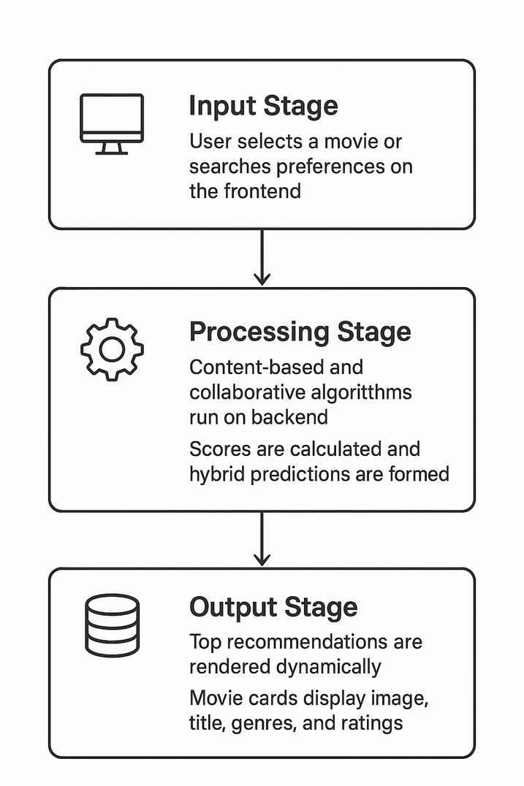
System Workflow
Input Stage:
User selects a movie or searches preferences on the frontend
Processing Stage:
Content-based and collaborative algorithms run on backend
Scores are calculated and hybrid predictions are formed
Output Stage:
Top recommendations are rendered dynamically
Movie cards display image, title, genres, and ratings

Slide 6
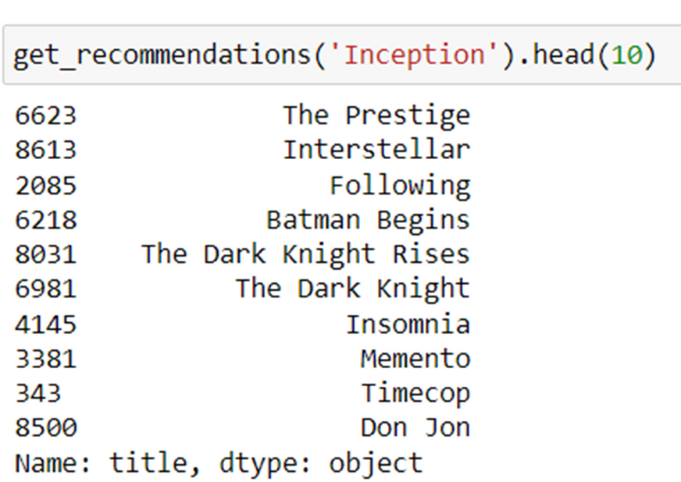
Recommendation Techniques (Content-Based )
Content-Based Filtering (Using NLTK):
Recommends movies based on similarity in features like overview, genres, keywords, director, cast.(Lops et al., 2011) [2], (Scikit-learn Developers, 2024) [7]
Uses Natural Language Toolkit (NLTK) for text preprocessing and feature extraction.
Computes similarity using cosine similarity on processed data.

Slide 7
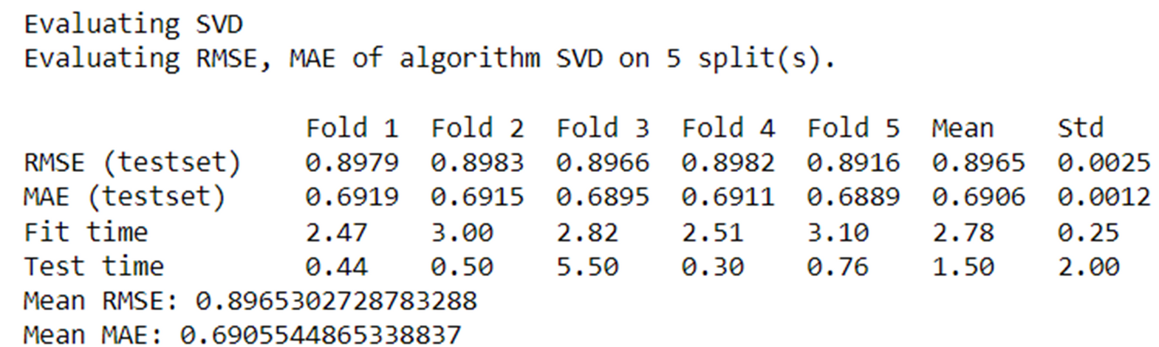
Recommendation Techniques (Collaborative)
Collaborative Filtering (Using SVD):
Uses user-item interaction data to predict preferences.
Implements Singular Value Decomposition (SVD) to identify latent patterns in user ratings.(Koren et al., 2009) [1], (Surprise Library Documentation, 2024) [4]
Effective in capturing hidden relationships among users and movies.

Slide 8

Hybrid Approach Implementation
Our project combines both content-based and collaborative filtering techniques to create a hybrid recommendation system. This approach leverages the strengths of both methods to provide more accurate and diverse recommendations to users.
Benefits:
Improved Accuracy – Better matches to user tastes
Diverse Suggestions – Goes beyond user’s viewing history
Cold Start Solution – Handles lack of data more gracefully

Slide 9
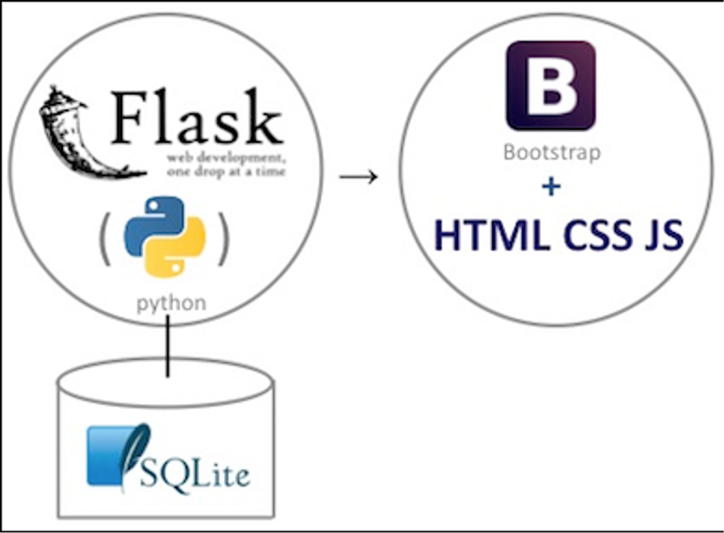
Flask Integration
Flask connect backend to frontend. (Flask Documentation, 2024) [6]
Workflow
GET Request: Loads homepage with movie input/search bar
POST Request: Captures input, sends to recommend function
Returns a list of top recommended movies
Overview of app.py
Central backend logic using Flask
Connects ML model with frontend
Fetches movie data from TMDB API and sends results to React

Slide 10
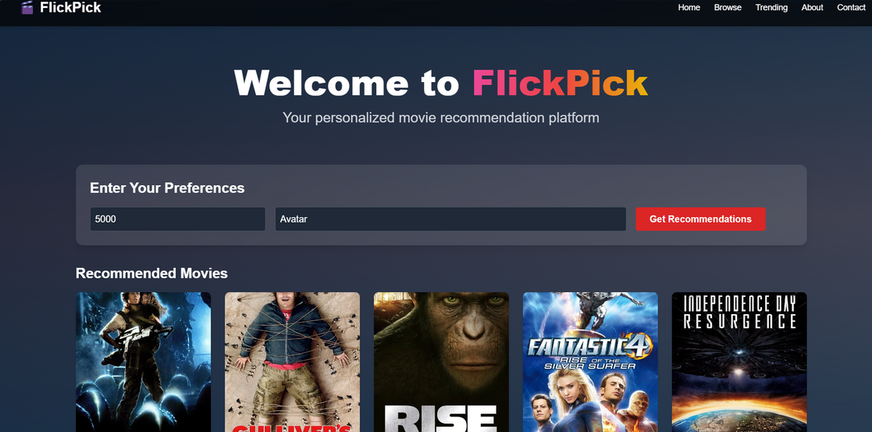
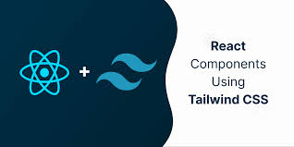
Frontend
Technology Stack:
React.js + Tailwind CSS
Animated background using react-tsparticles
Movie cards with hover effects (title, genre, rating, synopsis)
Sections: Search, Trending, Top Rated, Filters
UI Highlights:
Sticky navigation bar
Responsive design
Custom floating background )
Smooth transitions for cards and filters
Deployment:
Frontend hosted on Netlify
API calls to Flask backend on Render
Images and movie data © TMDB – https://www.themoviedb.org

Slide 11
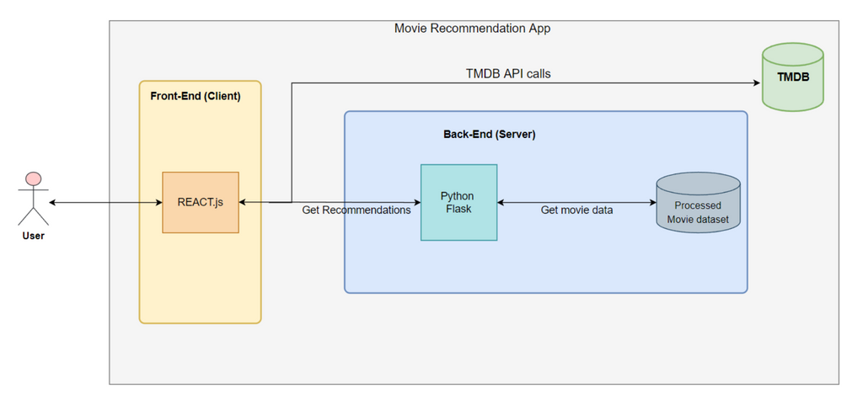
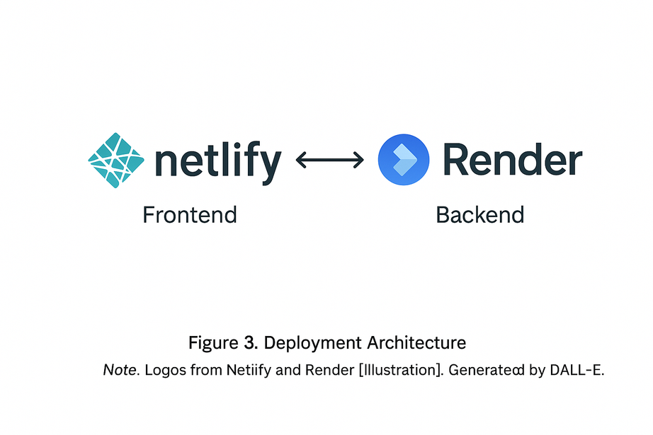
Deployment
Frontend Deployment:
Deployed using Netlify
React.js + Tailwind CSS based UI
Live user interface accessible via public URL
Handles routing, animations, and fetch calls to backend
Backend Deployment:
Hosted on Render
Python Flask backend running ML models
Integrated with TMDB API for real-time movie data
REST API endpoints used by frontend for recommendations
Architecture diagram from GitHub React-Flask Movie Recommendation App

Slide 12
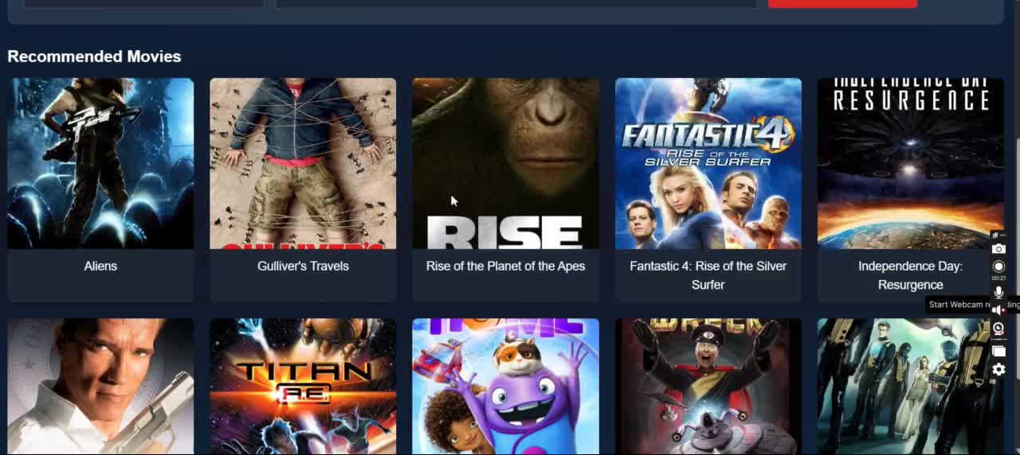
Project Demo
Images and movie data © TMDB – https://www.themoviedb.org

Slide 13
Challenges Faced
•Data Quality: Ensuring the quality and completeness of the movie datasets for accurate recommendations.
•Algorithm Complexity: Understanding and implementing the SVD algorithm for collaborative filtering.
•Integration Complexity: Integrating content-based and collaborative filtering into a hybrid model with seamless functionality.
•Deployment Challenges: Overcoming deployment challenges, such as hosting the Flask application on Render and ensuring scalability and performance.

Slide 14
Future Enhancements
Add user login system with watch history
Support user ratings and feedback loop
Integrate with transformer models like BERT for deeper NLP-based similarity
Add multi-language support and subtitle preview
Create mobile app version
Conclusion
FlickPick blends smart ML algorithms with a dynamic frontend to deliver accurate and visually appealing movie recommendations.
Its hybrid engine ensures personalization, while future upgrades aim to make it smarter and more inclusive.

Slide 15
References
Koren, Y., Bell, R., & Volinsky, C. (2009). Matrix Factorization Techniques for Recommender Systems. IEEE Computer, 42(8), 30–37.
Lops, P., de Gemmis, M., & Semeraro, G. (2011). Content-based Recommender Systems: State of the Art and Trends. In Recommender Systems Handbook (pp. 73–105). Springer.
Burke, R. (2002). Hybrid Recommender Systems: Survey and Experiments. User Modeling and User-Adapted Interaction, 12, 331–370.
Surprise Library Documentation. (2024). An Easy-to-Use Python Library for Collaborative Filtering. Retrieved from https://surpriselib.com
TMDB API Documentation. (2024). The Movie Database (TMDb) API. Retrieved from https://developers.themoviedb.org
Flask Documentation. (2024). Flask: Web Development with Python. Retrieved from https://flask.palletsprojects.com
Scikit-learn Developers. (2024). Machine Learning in Python - Scikit-learn Documentation. Retrieved from https://scikit-learn.org

Slide 16
Thank You

